Slide 1

Hazy Shade of Winter…
2024-2025 Snow Season
Presentation
Dan Merkh
Public Works Director

Slide 2
Winter HISTORY 2023-2024 SEASON
Dec. 26-28
Light Snow
Training
Jan. 8-9
Long Duration Winter Storm
9” Snow Totals
Jan. 11-12
Light Snow/Sleet/Ice
Low Temperatures & Windy Conditions
Jan. 13
Light Snow
Extremely Low Temperatures & Windy
January 18-19
January 21-23
February 16
Light Snow
Windy Conditions
Freezing Rain / Drizzle
Road temps hovered near freezing with spotty slick spots
Light Glaze of Ice Overnight
Snow

Slide 3
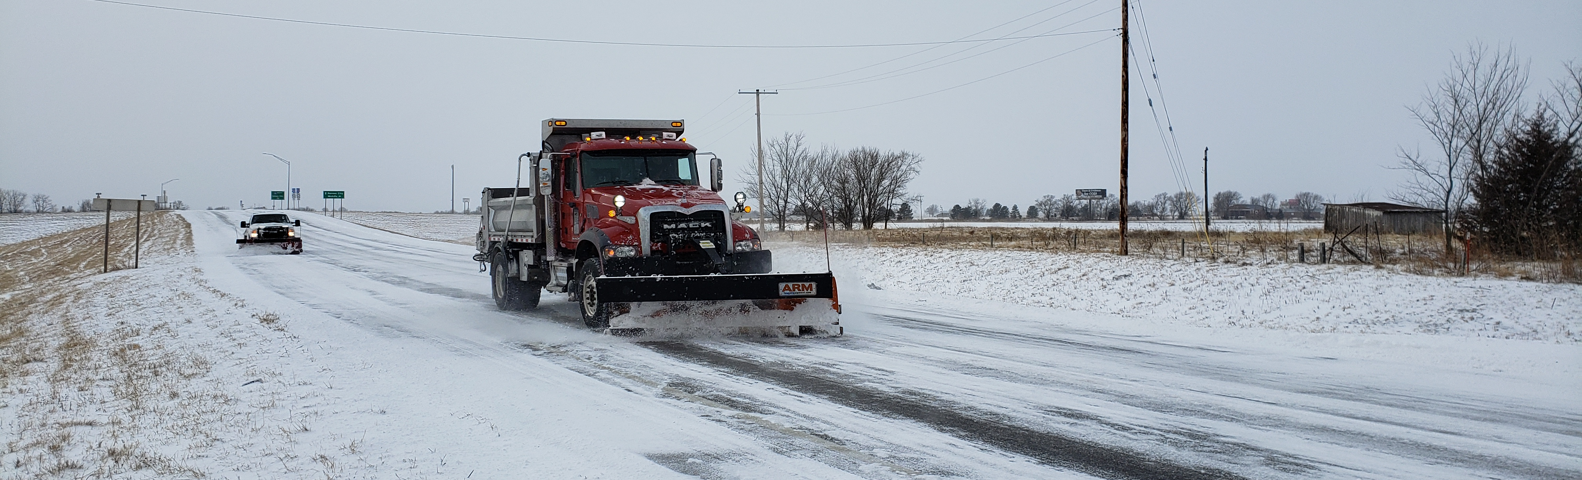
When do we begin snow and ice control operations?
Crews work 12-hour shifts
Treatment methods determined by the forecast
Public Works Director makes the call to begin operations
We monitor road conditions using:
  Weather or Not
  Pavement temperature sensors; and
  Visual inspection by Public Works

Slide 4

Types of Response
Forecast Dependent
Proactive
Pretreatment based on forecast
Staff activation in advance of snowfall
Reactive
Staff activation based on conditions

Slide 5
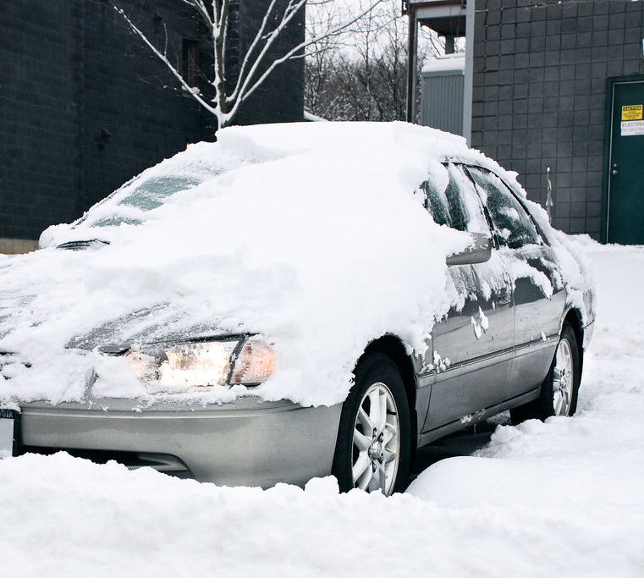
Snow Event Declaration
Once two or more inches of snow has fallen, we can declare a “snow event”
Municipal Code (Ch. 13, Art. 4, Sec. 406) requires all vehicles parked on City streets to be moved within two hours of a snow event declaration
  The owners are responsible for any tow fees

Slide 6

Notifications
Direct alerts through Notify JoCo and posted on edgertonks.org
Social media posts when vehicles must be removed from the street
Sheriff’s Office tows vehicles that are not moved

Slide 7
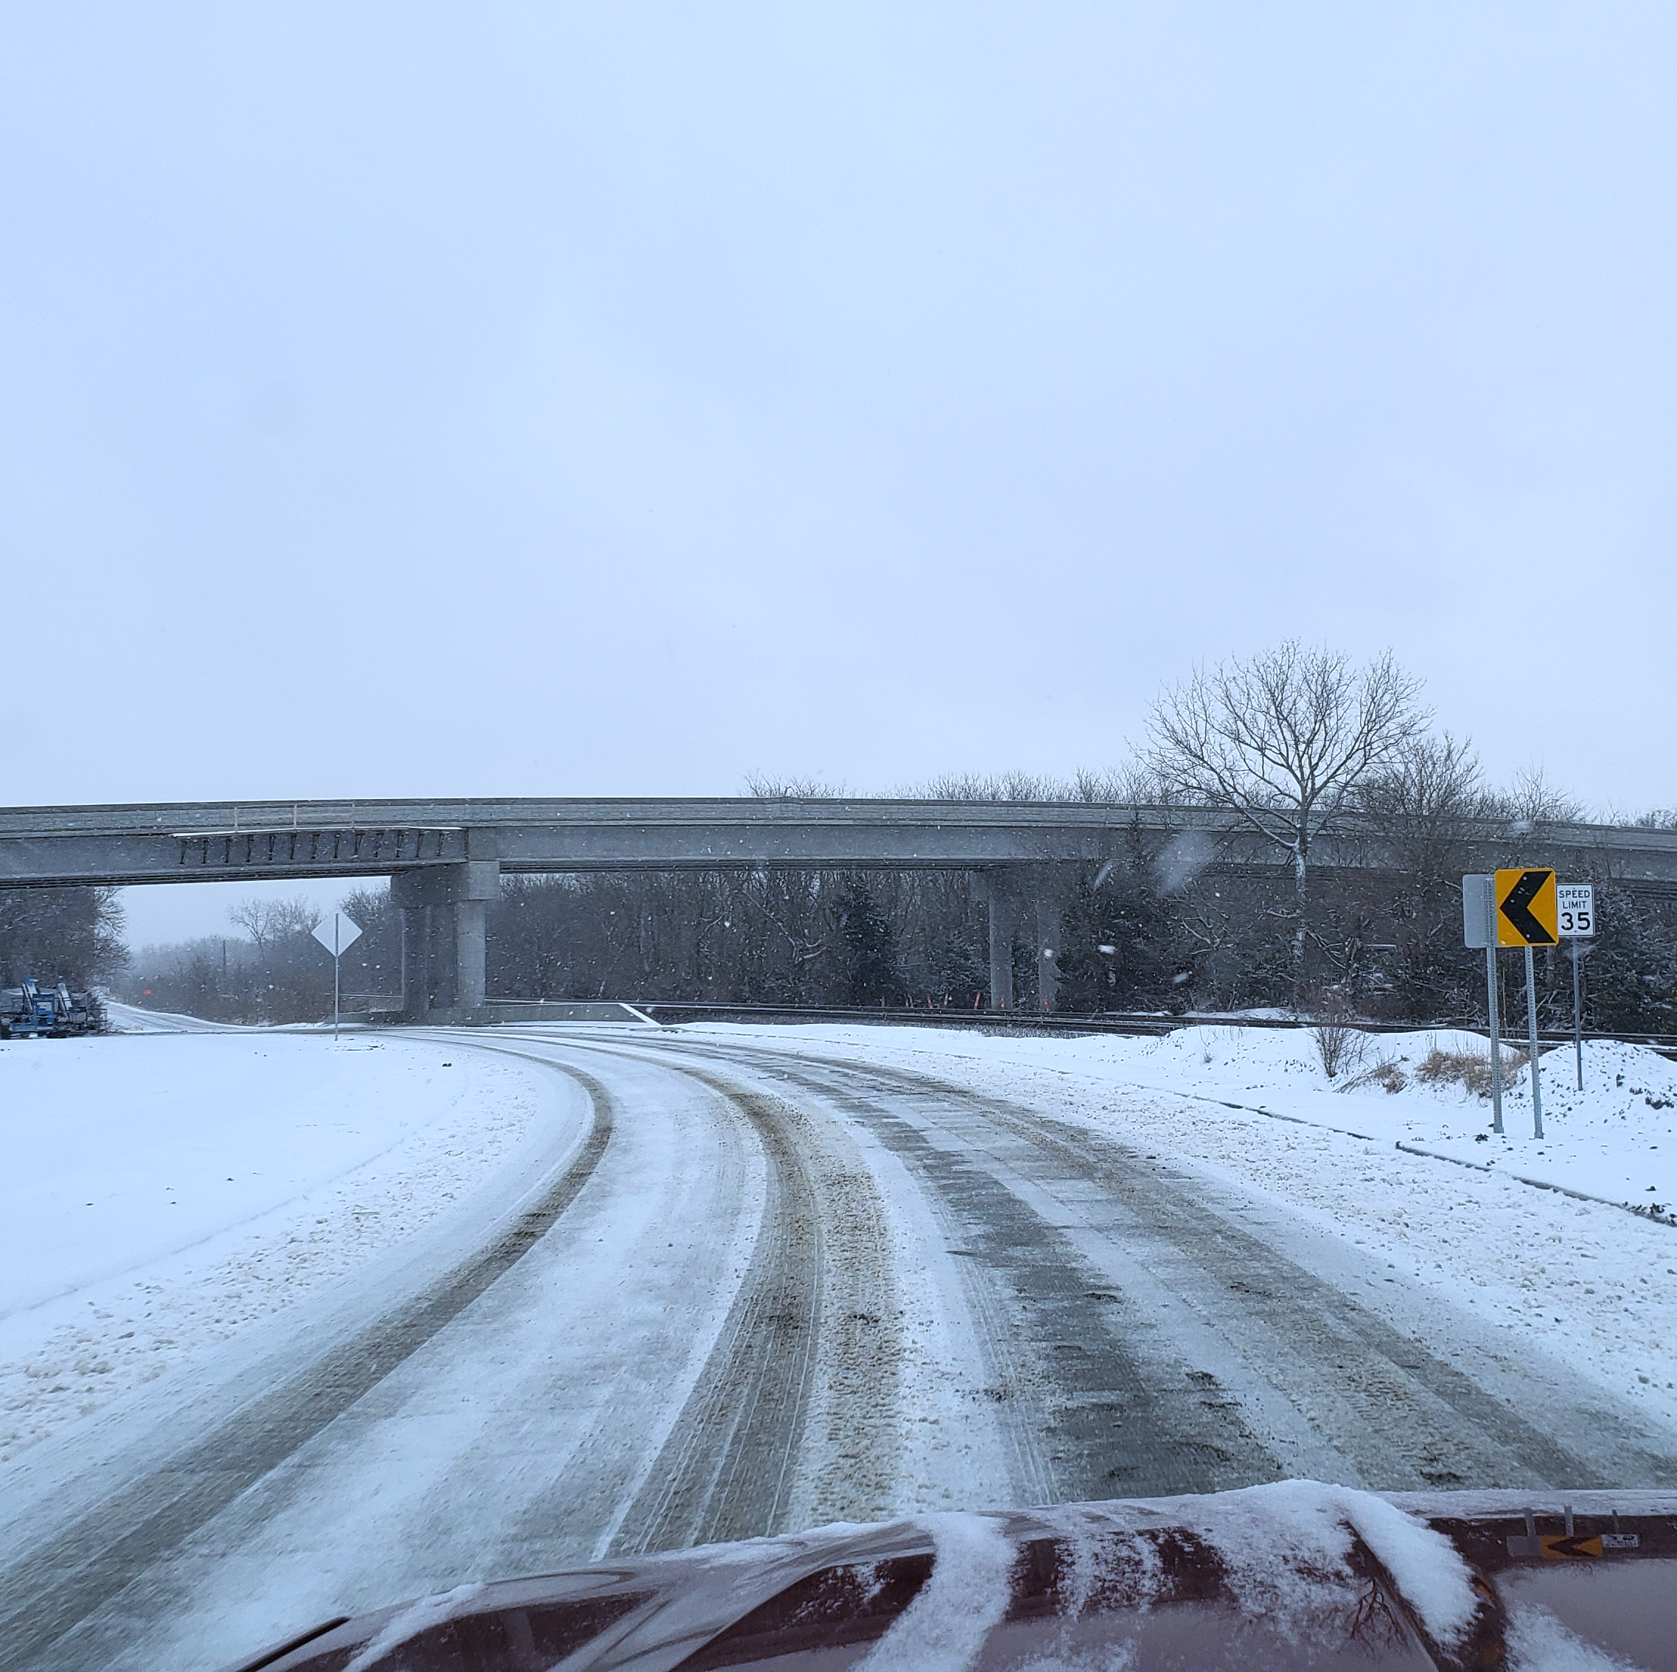
How We Manage Snow & Ice
Vehicles
Four 1-ton Trucks
Chemicals
Salt
One single-axle dump truck
Brine
One tandem axle dump truck
One Motor Grader

Slide 8
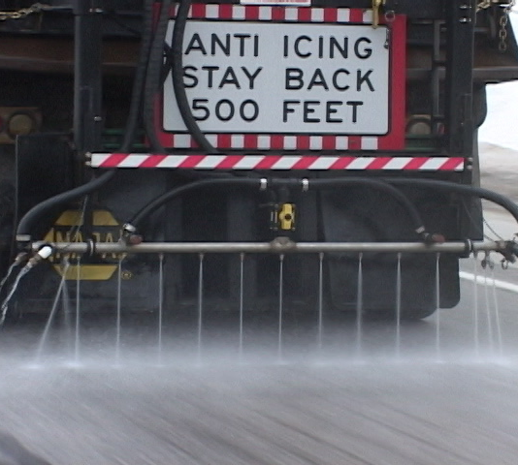
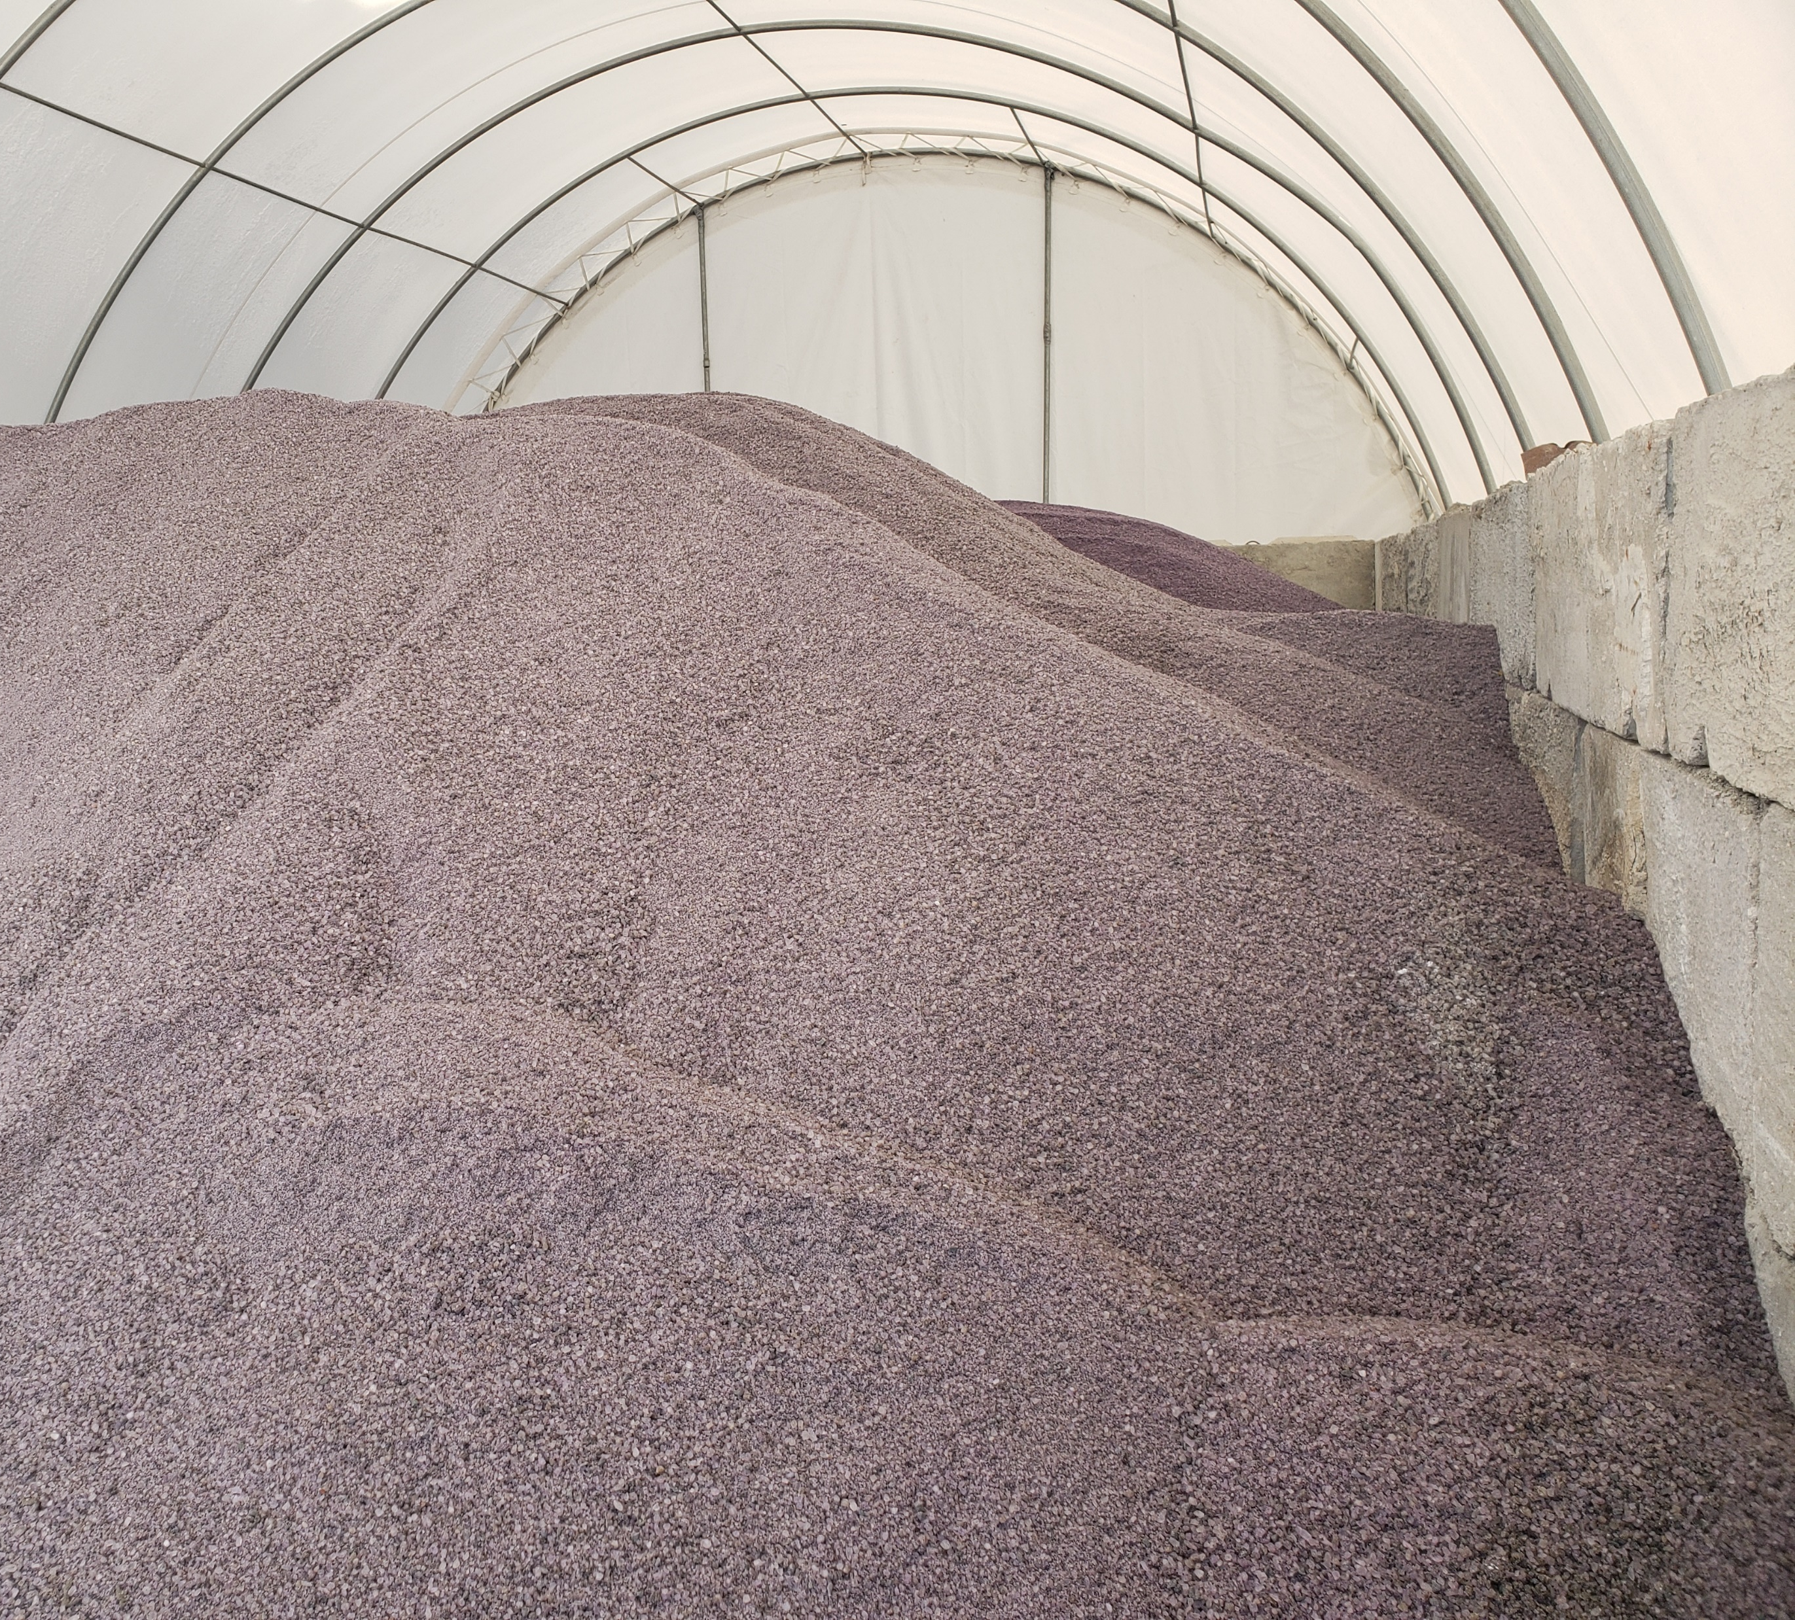
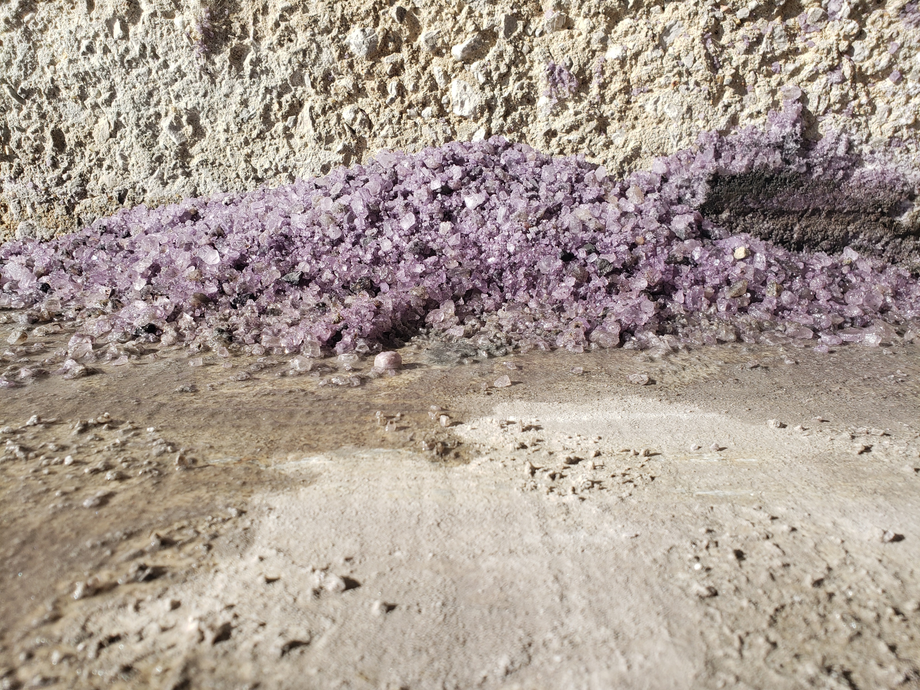
What treatments do we use for snow and ice?
Enhanced salt
  Melts ice faster than other deicers
Brine (calcium chloride)
  Used for pre-treatment
  Slows down the freezing by creating a barrier between the pavement and precipitation

Slide 9
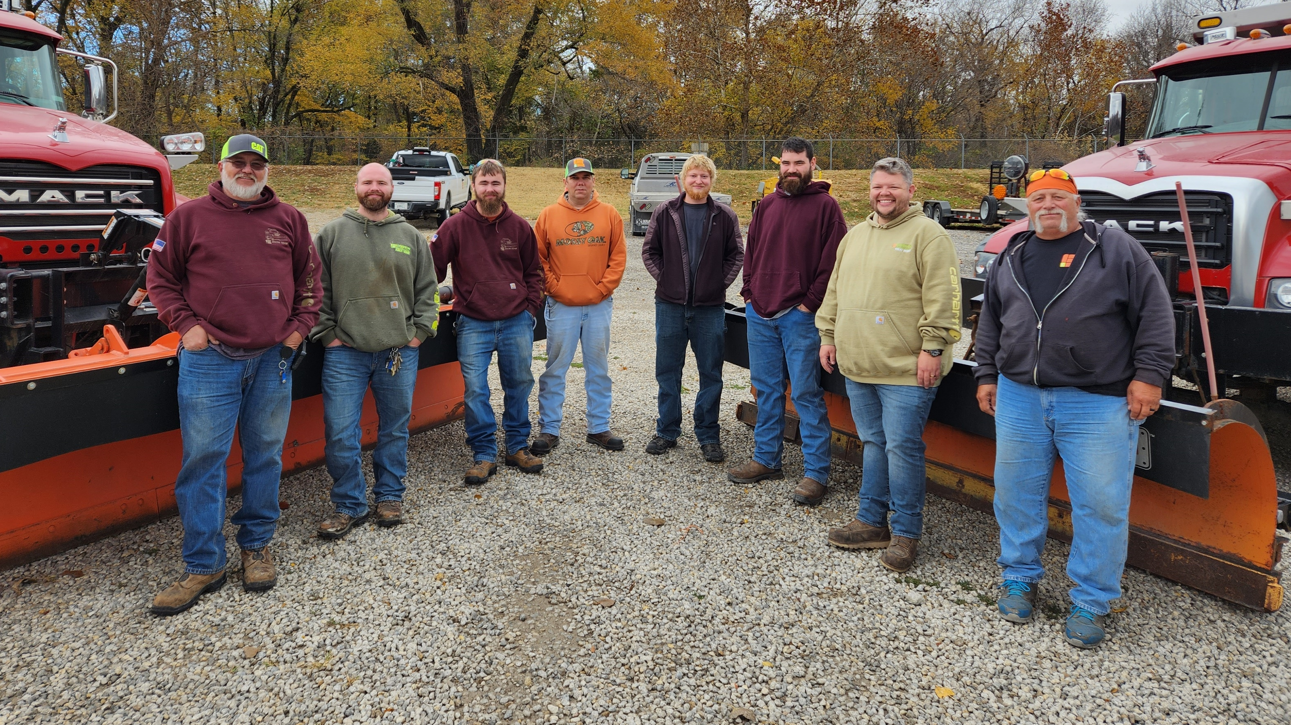
The Crew
The Crew

Slide 10

Plowing Procedure
Roads are divided into 3 priorities
Priority 1
Major thoroughfares with higher traffic counts
Priority 2
Neighborhood Roads
Priority 3
Culd-de-sacs, dead ends & alleys
Plows are not diverted from their routes, except in cases of fire or police emergencies

Slide 11
Plowing Procedure
Priority 1
Major thoroughfares with higher traffic counts
Priority 2
Neighborhood Roads
Priority 3
Culd-de-sacs, dead ends & alleys
Roads are divided into 3 priorities
Plows are not diverted from their routes, except in cases of fire or police emergencies

Slide 12
Plowing Procedure
Priority 2
Neighborhood Roads
Priority 3
Culd-de-sacs, dead ends & alleys
Roads are divided into 3 priorities
Priority 1
Major thoroughfares with higher traffic counts
Plows are not diverted from their routes, except in cases of fire or police emergencies

Slide 13
Plowing Procedure
Priority 3
Culd-de-sacs, dead ends & alleys
Priority 2
Neighborhood Roads
Roads are divided into 3 priorities
Priority 1
Major thoroughfares with higher traffic counts
Plows are not diverted from their routes, except in cases of fire or police emergencies

Slide 14
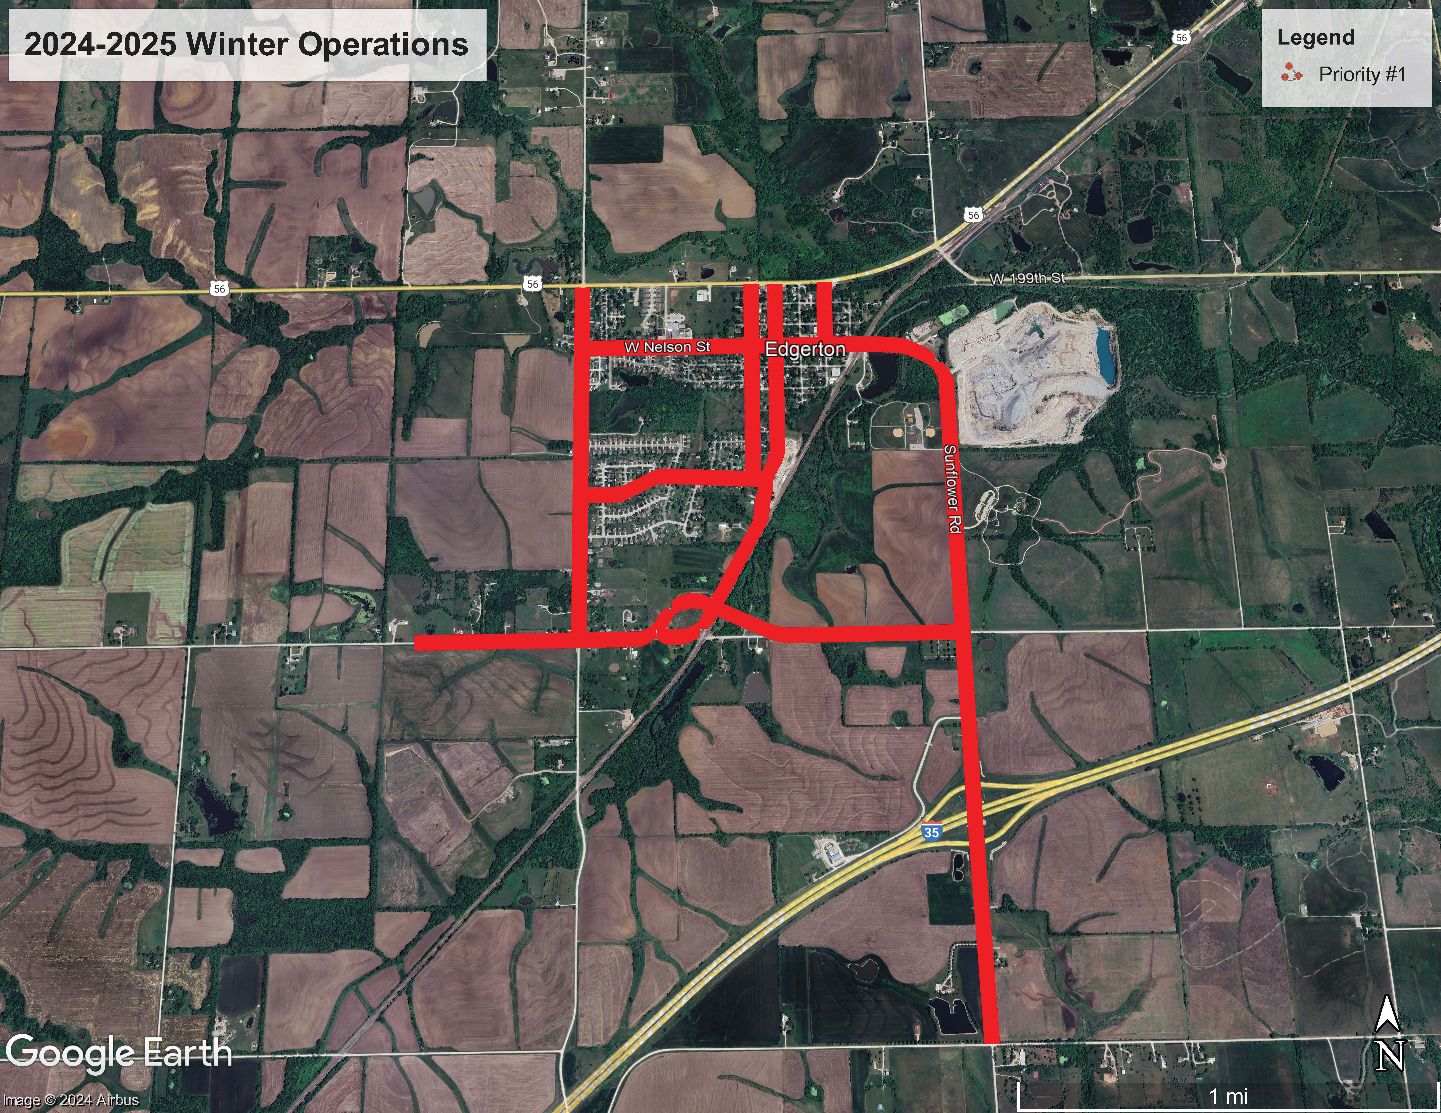

Slide 15
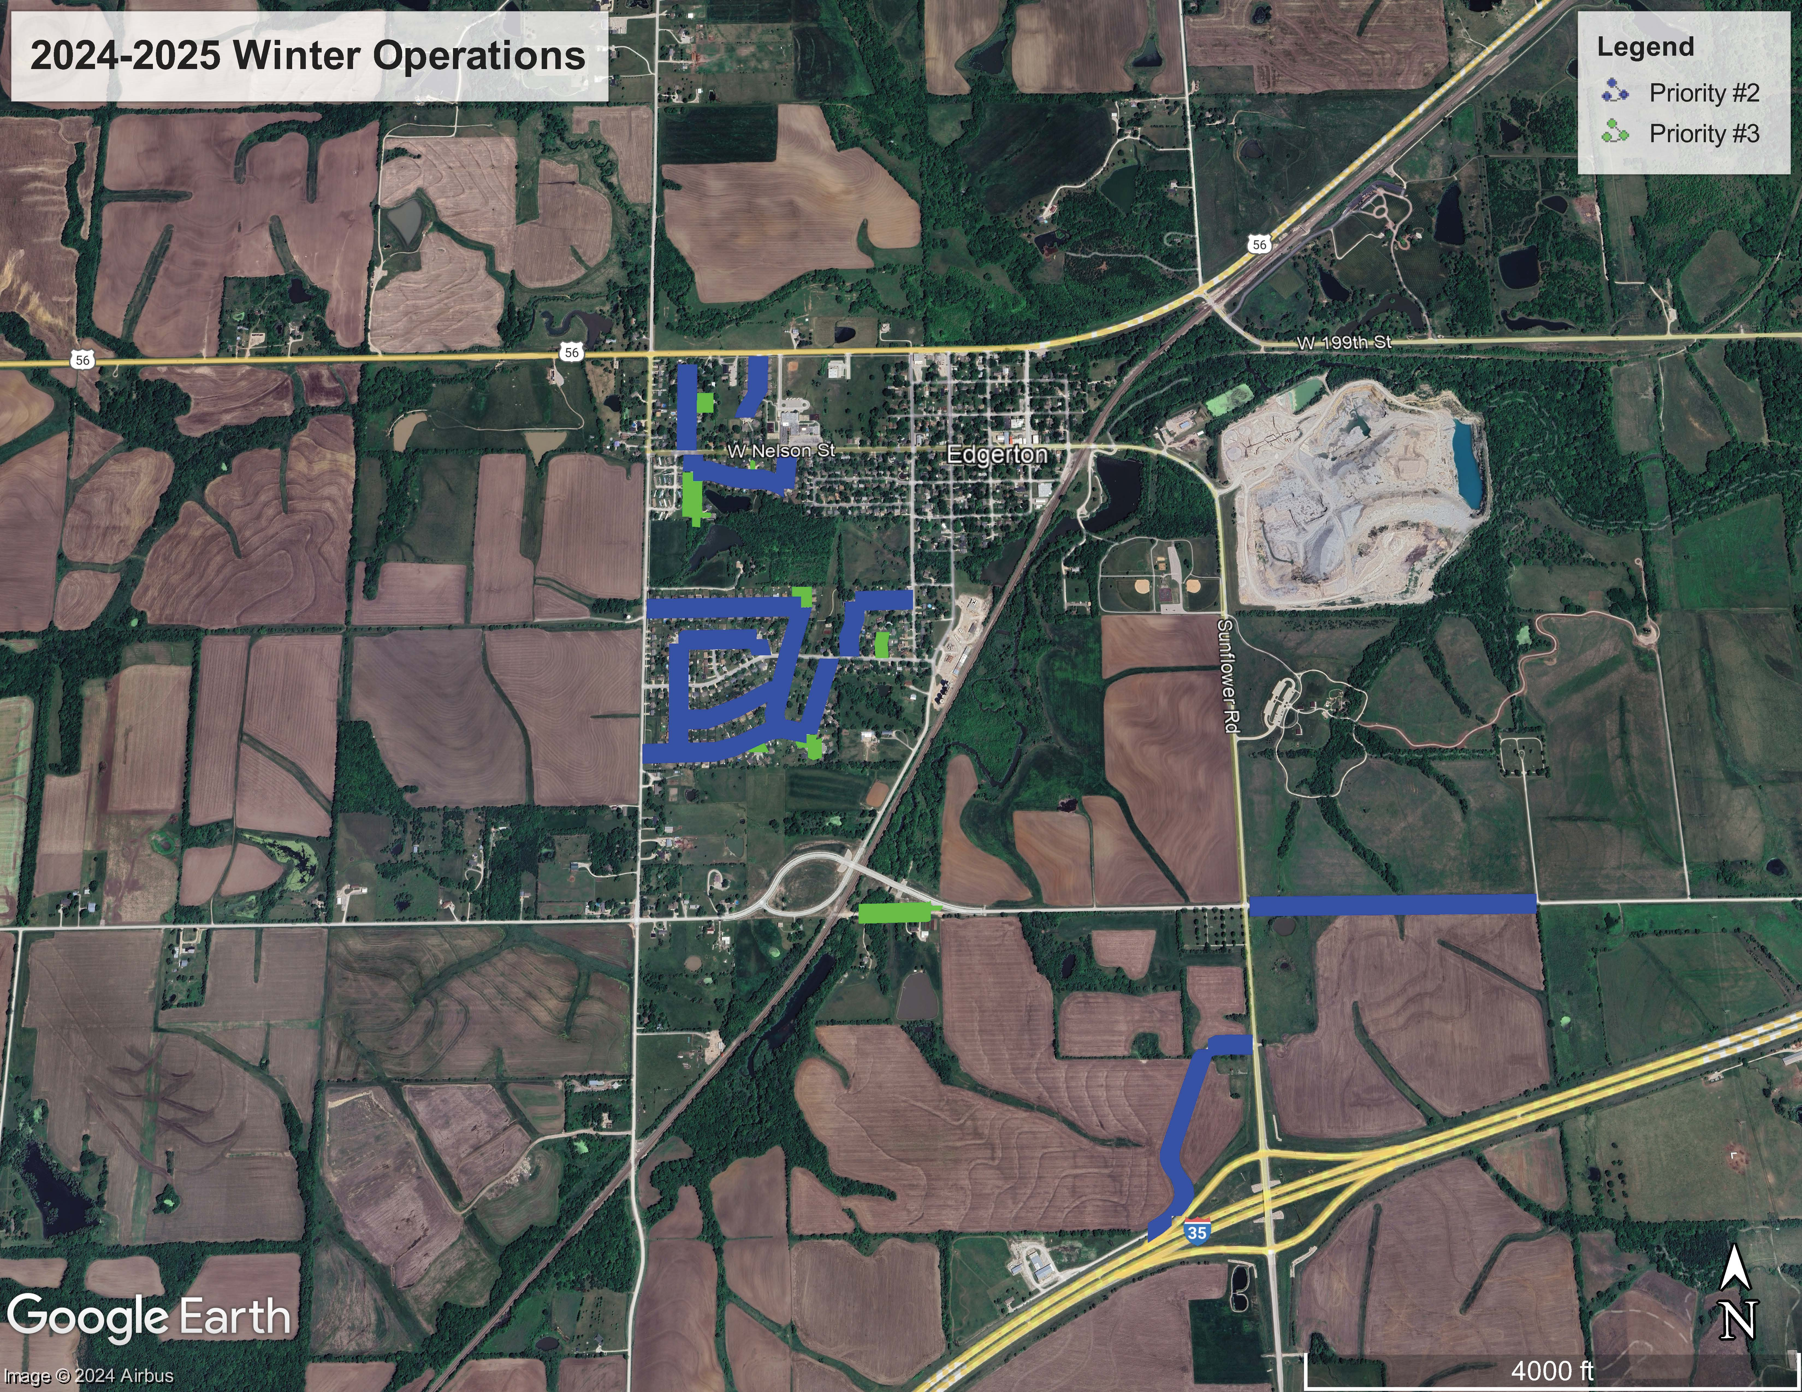

Slide 16
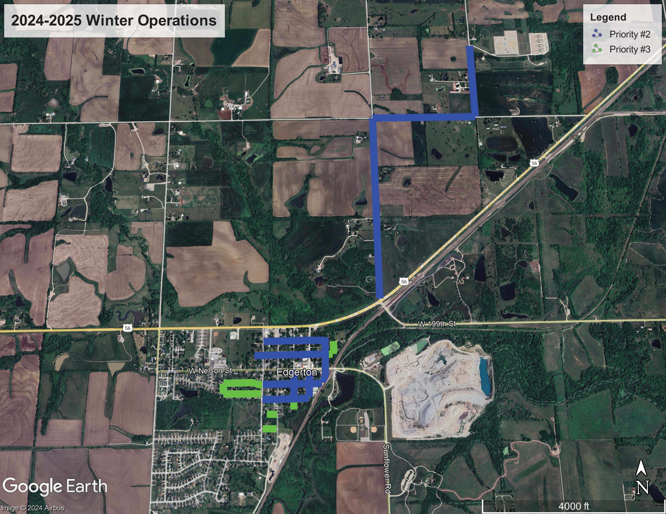

Slide 17
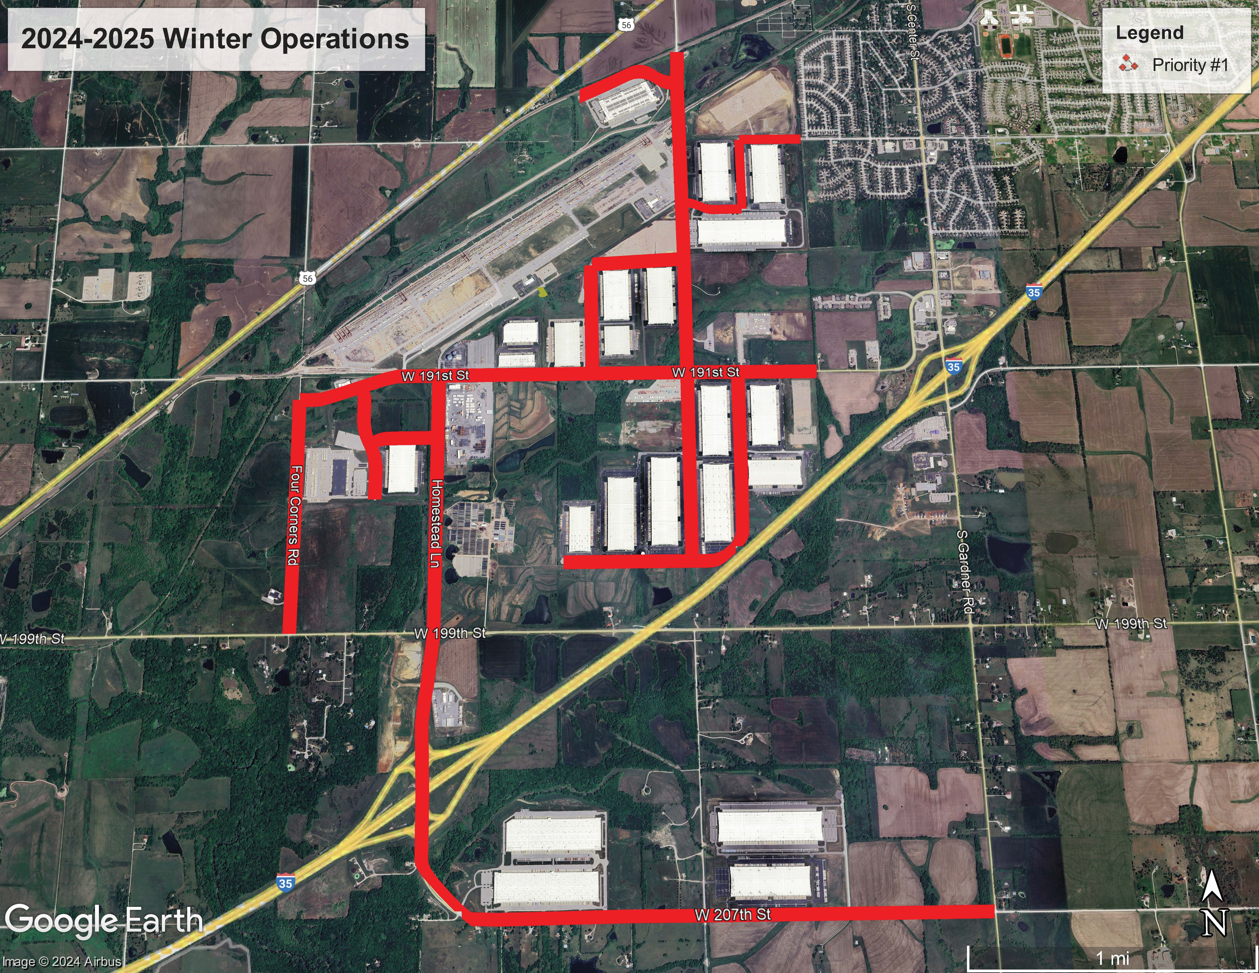

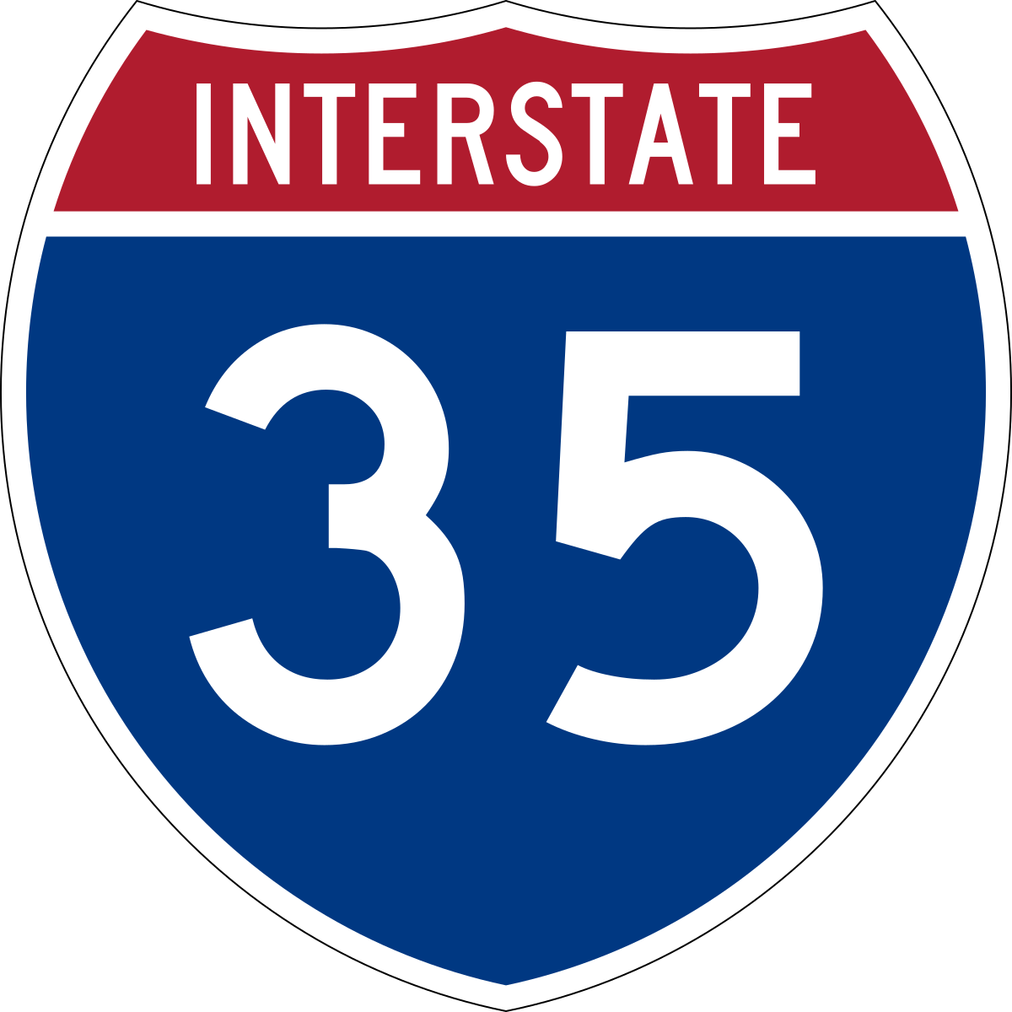
207th St

Slide 18
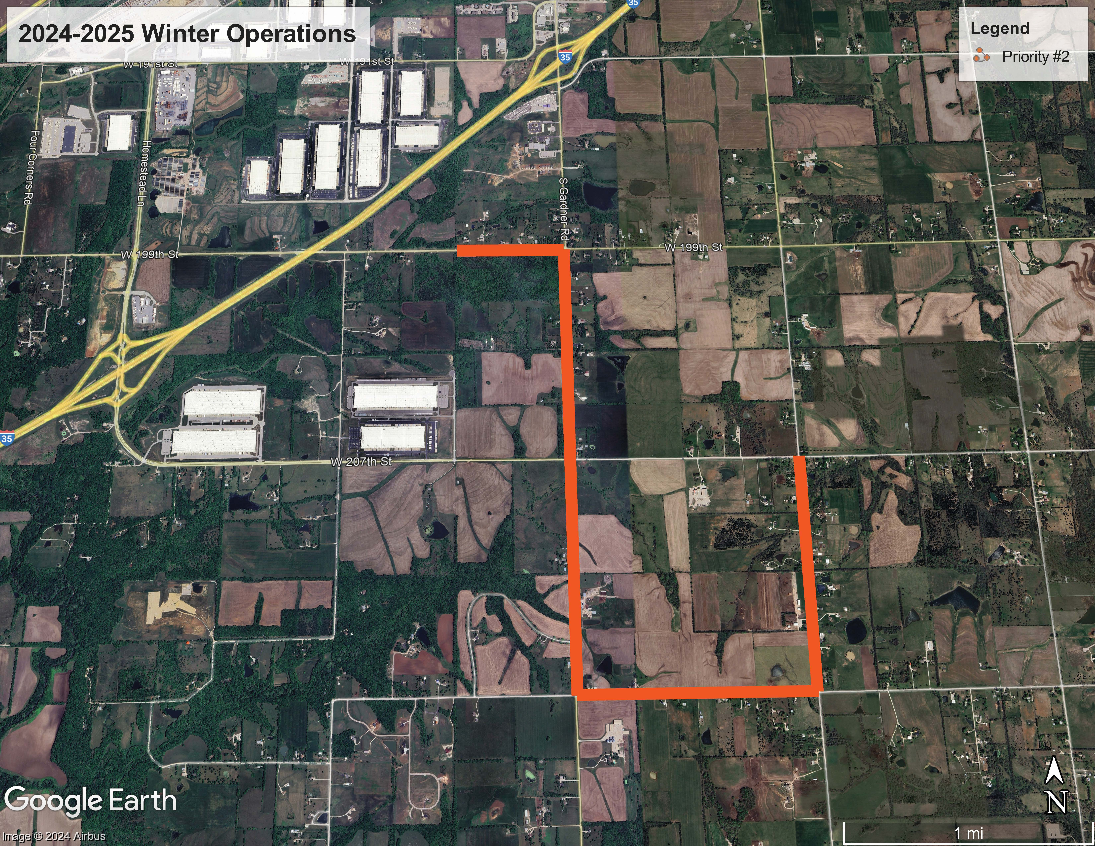
Homestead

Slide 19
Homestead

Slide 20
City-cleared sidewalks and trails
Once the roads are cleared curb-to-curb…
Any parking lots and sidewalks adjacent to city facilities are cleared by Public Works or other City employees
City crews plow trails

Slide 21
Clearing Sidewalks and Private Drives
Residents are responsible for clearing sidewalks in front of their homes within 48 hours of the end of the winter weather event
The City does not clear sidewalks, private driveways or parking lots
Notification: City will declare the “end of snow event” to start the clock for residents to clear sidewalks

Slide 22
Let’s all have a safe winter season!

